Slide 1

rthrtgtg
ОБЗОР РЫНКА ФАСТФУД-РЕСТОРАНОВ НЕКОТОРЫХ ГОРОДОВ США ДЛЯ
СТАРТАПА
Columbus, Ohio
Cincinnati, Ohio
Cleveland, Ohio
Las Vegas, Nevada
Miami, Florida.
Indianapolis, Indiana
Birmingham, Alabama
Portland, Oregon

Slide 2
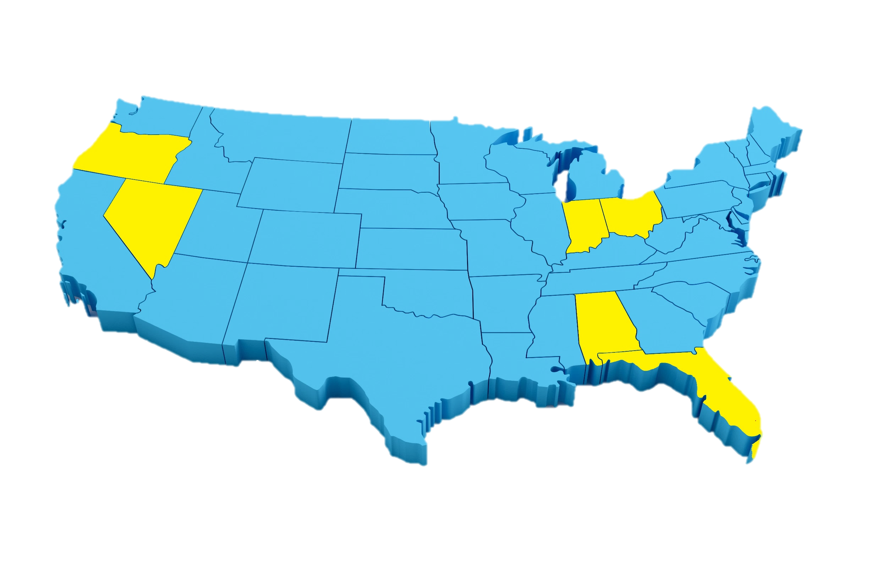

Portland
Review
Indianapolis
Oregon
Ohio
Indiana
Unit economics
Nevada
Cleveland
Columbus
Cincinnati
Alabama
Analytics
Florida
Las Vegas
Summaries
Birmingham
Miami

Slide 3
Portland
Review
Indianapolis
Oregon
Ohio
Indiana
Unit economics
Nevada
Cleveland
Columbus
Cincinnati
Alabama
Analytics
Florida
Las Vegas
Summaries
Birmingham
Miami

Slide 4
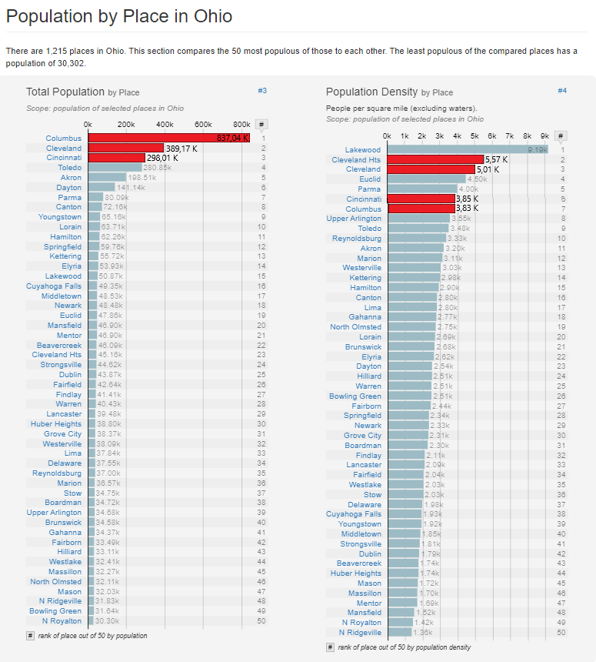
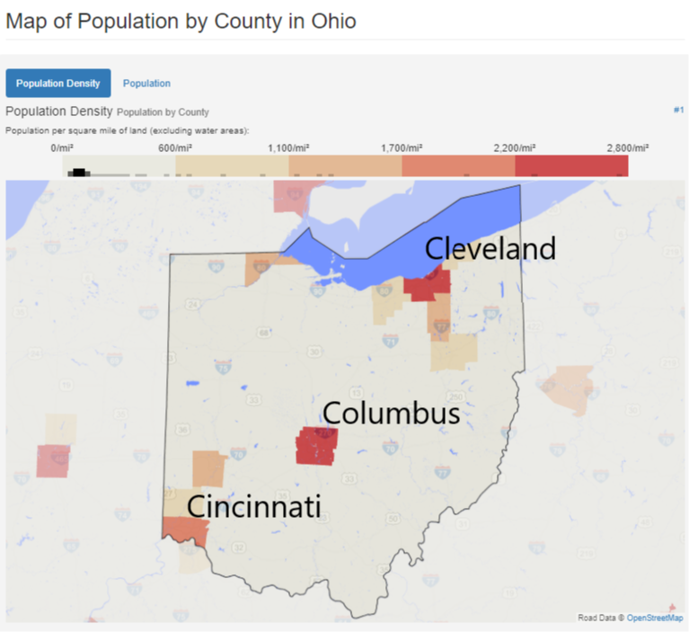
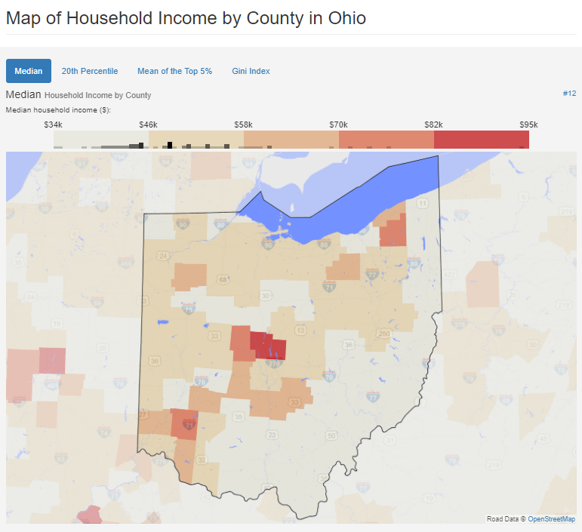
Portland
Review
Indianapolis
Oregon
Ohio
Indiana
Unit economics
Nevada
Cleveland
Доля конкурентов
Потенциал роста
Columbus
Cincinnati
Alabama
Analytics
Florida
Las Vegas
Summaries
Birmingham
Miami

Slide 5
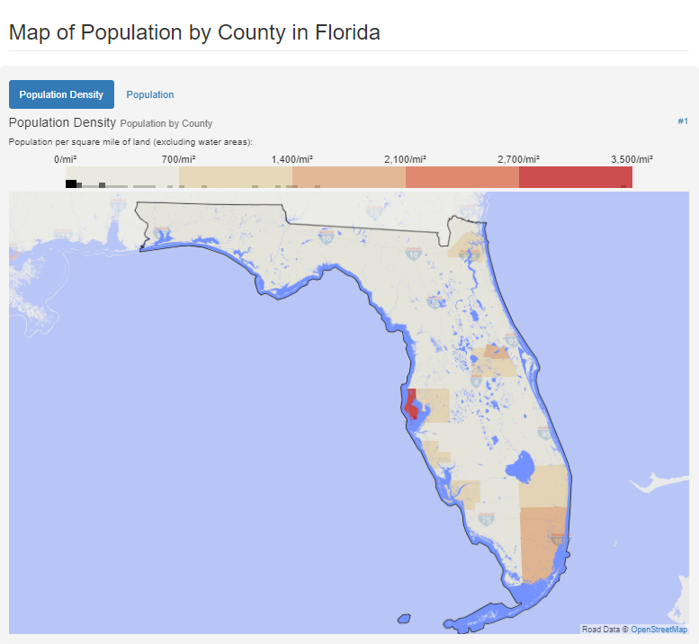
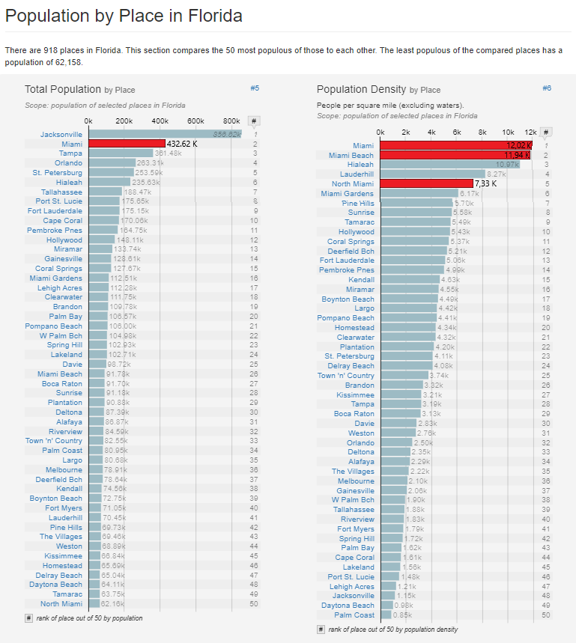
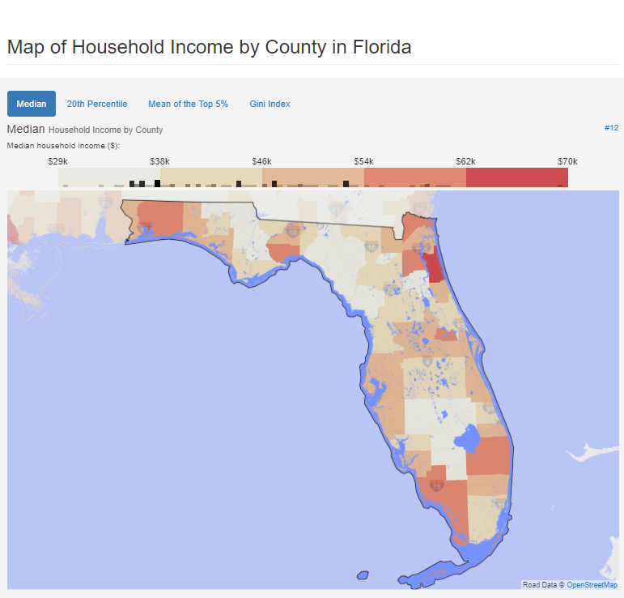
Portland
Review
Indianapolis
Oregon
Ohio
Indiana
Unit economics
Nevada
Miami
Cleveland
Доля конкурентов
Потенциал роста
Columbus
Cincinnati
Alabama
Analytics
Florida
Las Vegas
Summaries
Birmingham
Miami

Slide 6
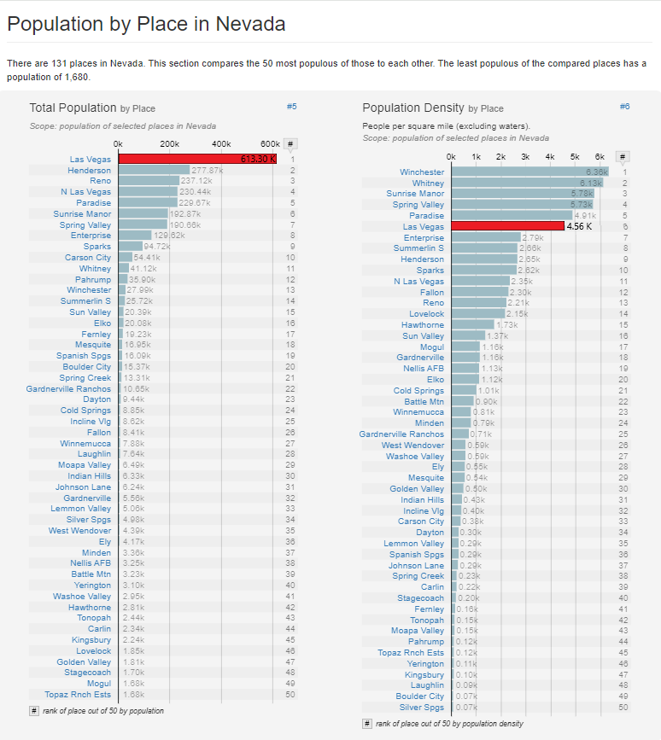
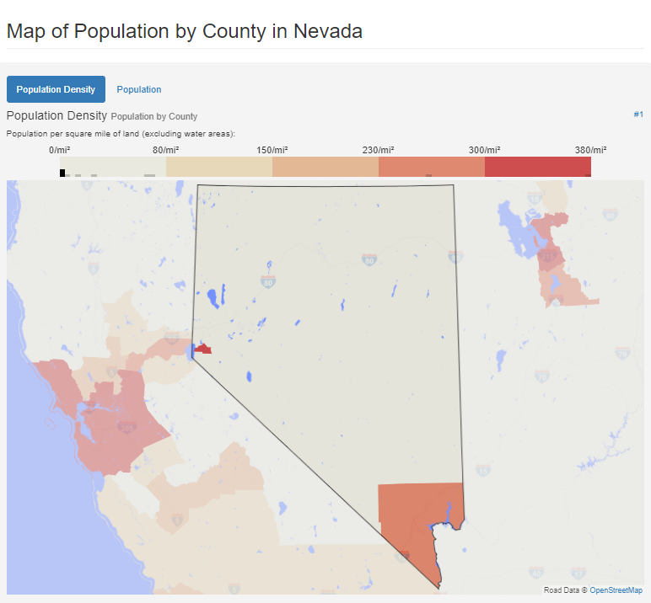
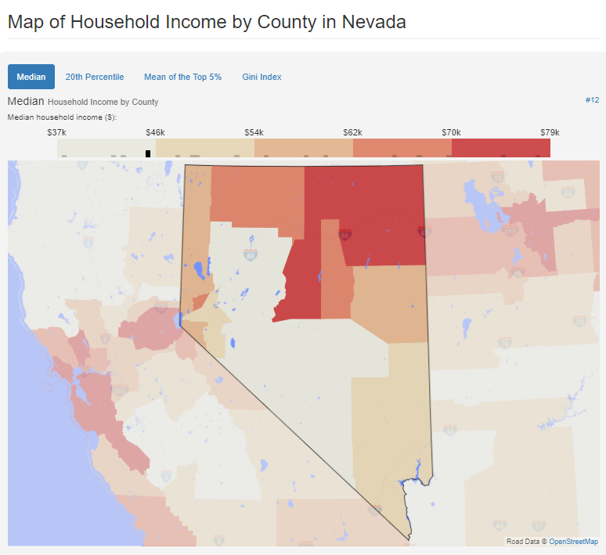
Portland
Review
Indianapolis
Oregon
Ohio
Indiana
Unit economics
Nevada
Las Vegas
Cleveland
Доля конкурентов
Потенциал роста
Columbus
Cincinnati
Alabama
Analytics
Florida
Las Vegas
Summaries
Birmingham
Miami

Slide 7
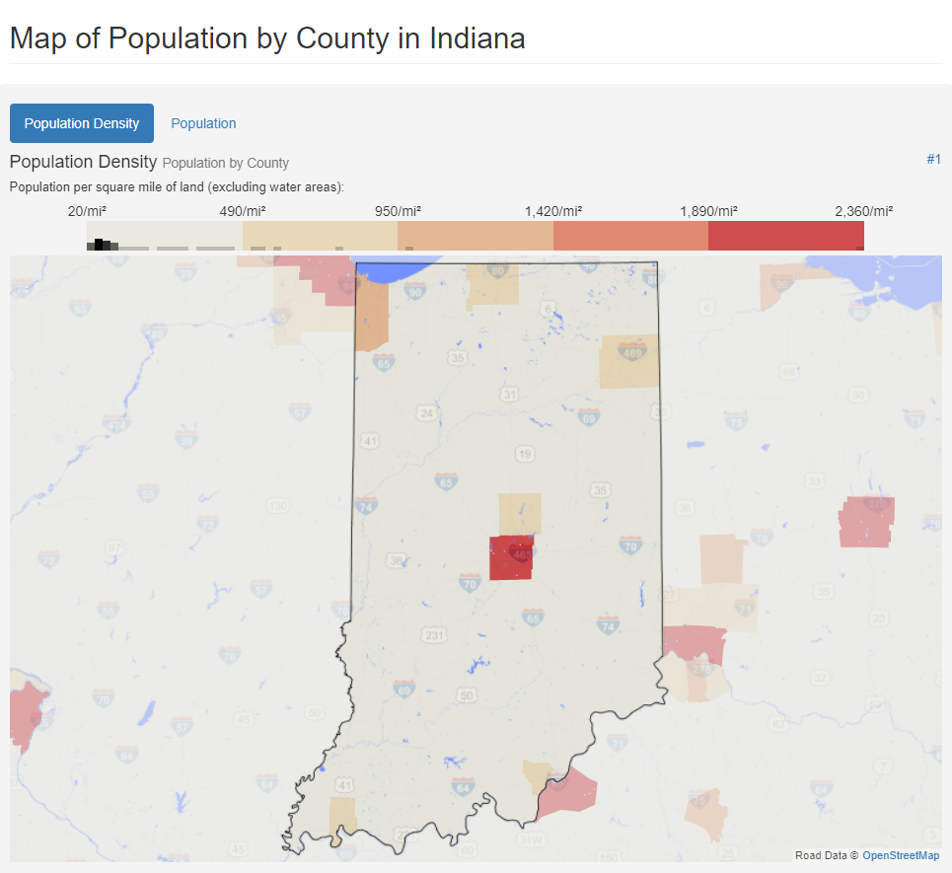
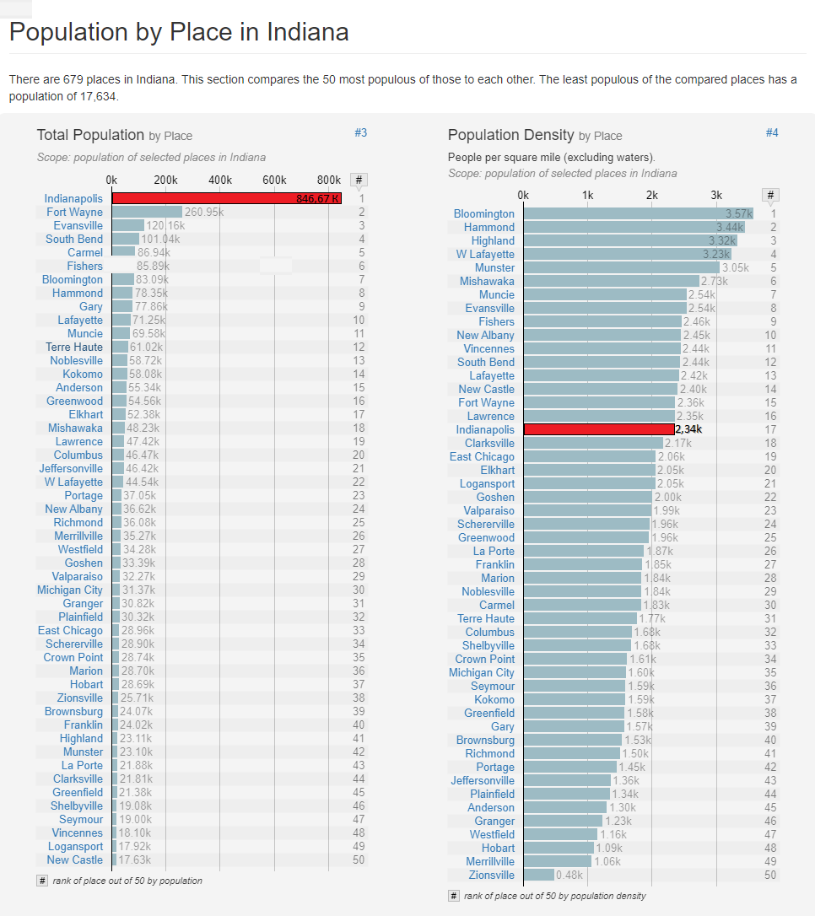
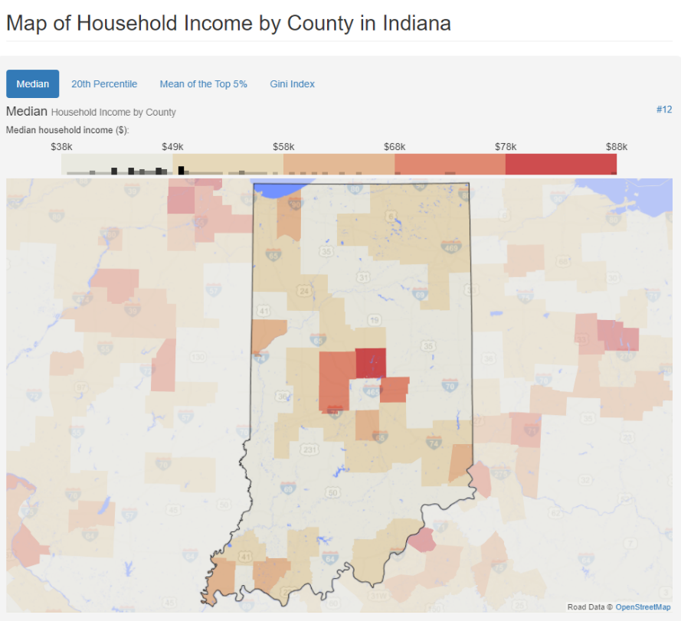
Portland
Review
Indianapolis
Oregon
Ohio
Indiana
Unit economics
Nevada
Indianapolis
Cleveland
Доля конкурентов
Потенциал роста
Columbus
Cincinnati
Alabama
Analytics
Florida
Las Vegas
Summaries
Birmingham
Miami

Slide 8
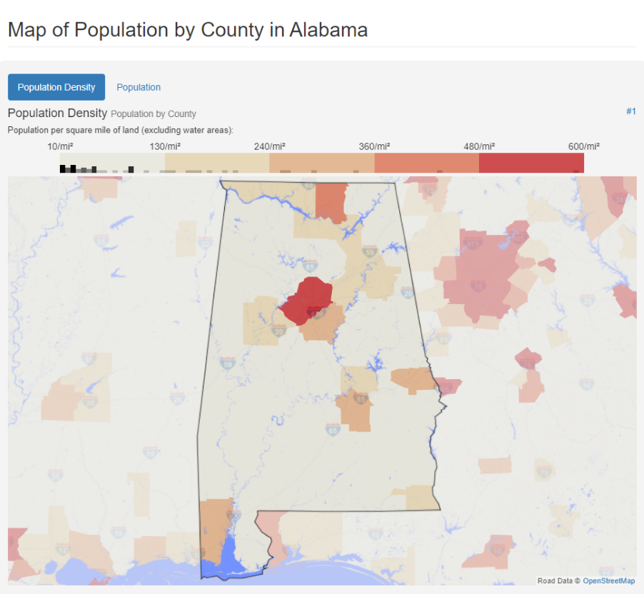
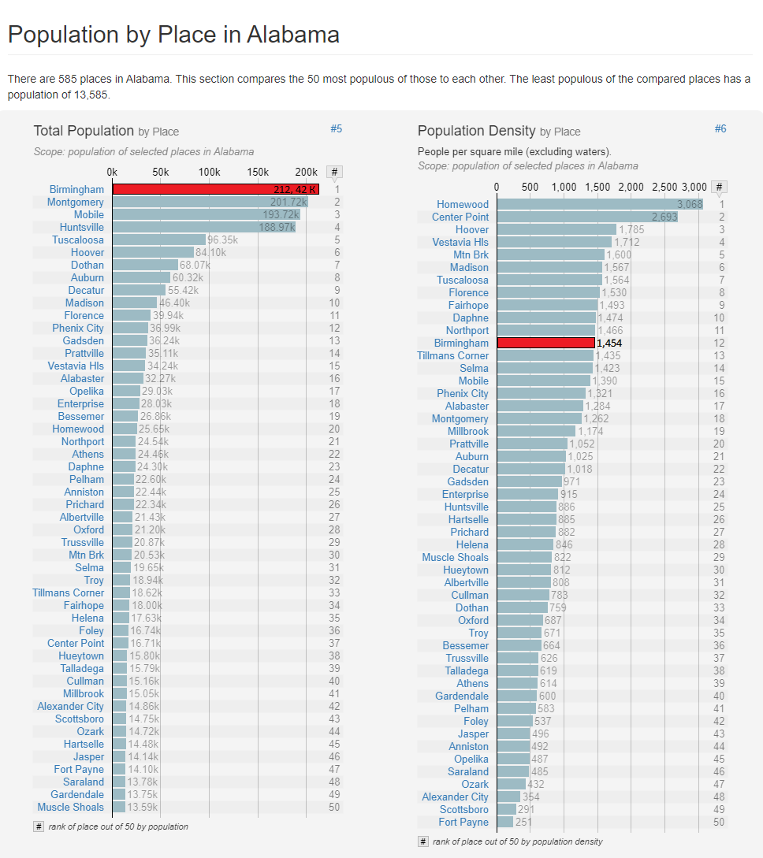
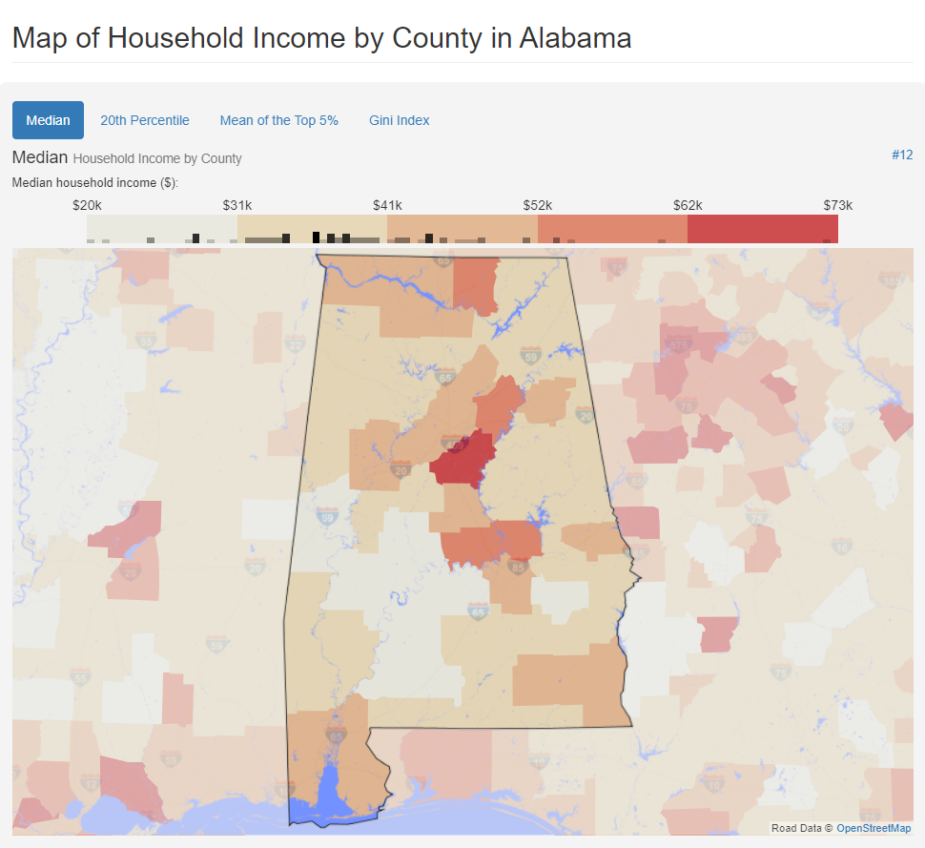
Portland
Review
Indianapolis
Oregon
Ohio
Indiana
Unit economics
Birmingham
Nevada
Cleveland
Доля конкурентов
Потенциал роста
Columbus
Cincinnati
Alabama
Analytics
Florida
Las Vegas
Summaries
Birmingham
Miami

Slide 9
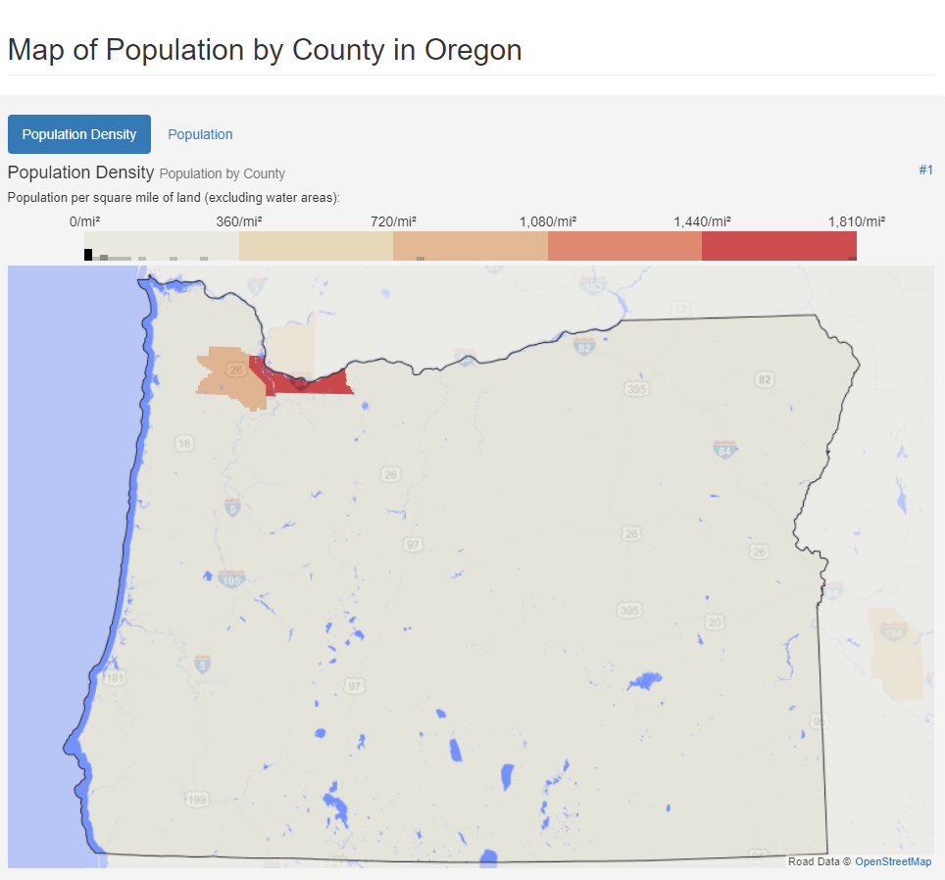
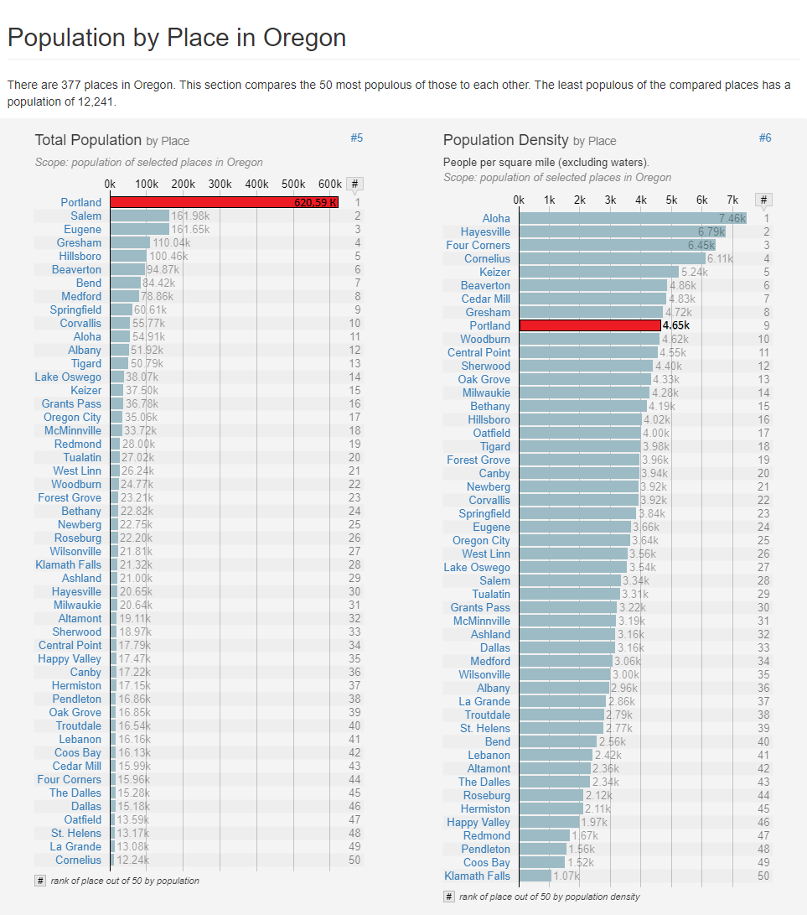
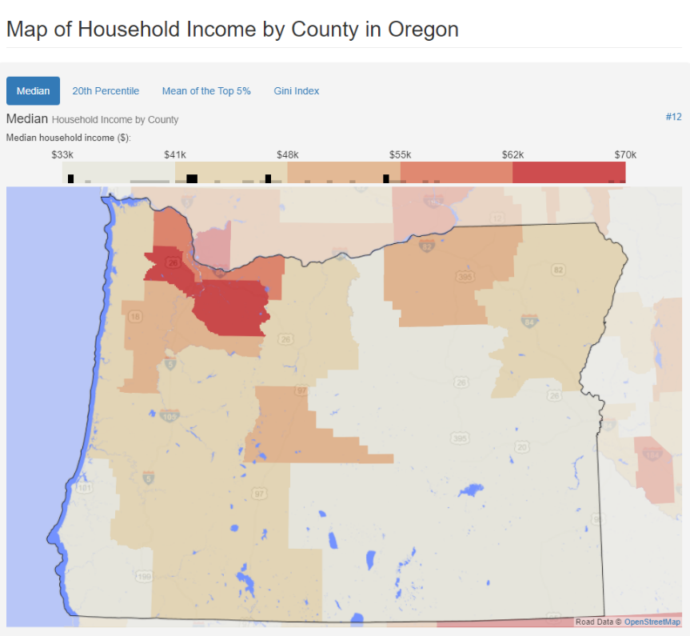
Portland
Review
Indianapolis
Oregon
Ohio
Indiana
Unit economics
Nevada
Portland
Cleveland
Доля конкурентов
Потенциал роста
Columbus
Cincinnati
Alabama
Analytics
Florida
Las Vegas
Summaries
Birmingham
Miami

Slide 10
Columbus, Ohio
Portland
Review
Indianapolis
Oregon
Ohio
Indiana
Unit economics
Nevada
Cleveland
Columbus
Cincinnati
Alabama
Analytics
Florida
Las Vegas
Summaries
Birmingham
Miami

Slide 11
Cincinnati, Ohio
Review
Unit economics
Analytics
Summaries

Slide 12
Cleveland, Ohio
Review
Unit economics
Analytics
Summaries

Slide 13
Las Vegas, Nevada
Review
Unit economics
Analytics
Summaries

Slide 14
Miami, Florida.
Review
Unit economics
Analytics
Summaries

Slide 15
Indianapolis, Indiana
Review
Unit economics
Analytics
Summaries

Slide 16
Birmingham, Alabama
Review
Unit economics
Analytics
Summaries

Slide 17
Portland, Oregon
Review
Unit economics
Analytics
Summaries

Slide 19
Юнит экономика
Portland
Review
Indianapolis
Oregon
Ohio
Indiana
Unit economics
Nevada
Cleveland
Columbus
Cincinnati
Alabama
Analytics
Florida
Las Vegas
Summaries
Birmingham
Miami

Slide 21
Аналитика
Portland
Review
Indianapolis
Oregon
Ohio
Indiana
Unit economics
Nevada
Cleveland
Columbus
Cincinnati
Alabama
Analytics
Florida
Las Vegas
Summaries
Birmingham
Miami

Slide 23
Заключение
Portland
Review
Indianapolis
Oregon
Ohio
Indiana
Unit economics
Nevada
Cleveland
Columbus
Cincinnati
Alabama
Analytics
Florida
Las Vegas
Summaries
Birmingham
Miami

